Slide 1
Data Mining: Advanced Techniques Recommender System
主讲教师: 陈佳伟, sleepyhunt@zju.edu.cn
https://jiawei-chen.github.io/
TA: 陈德仿, defchern@zju.edu.cn

Slide 2
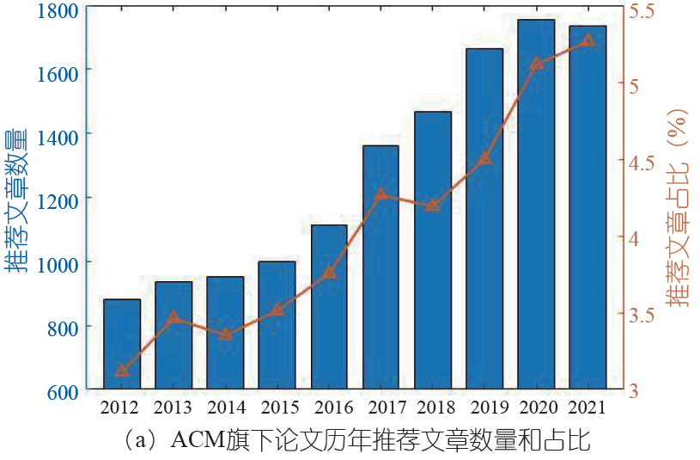
Why recommender system?
Recommender system has become a hot area in data mining
Notes:
机器学习是基础。

Slide 3
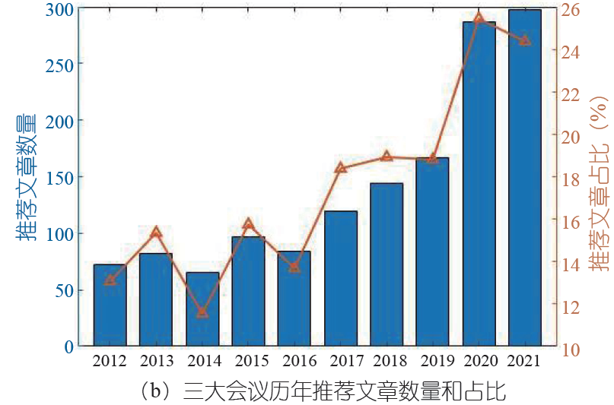
Why recommender system?
Recommender system has become a hot area in data mining
WWW、SIGIR、KDD
Notes:
机器学习是基础。

Slide 4
Why recommender system?
Important role of recommender system in many applications
Money Money Money: increasing sales revenue by more than 35% in Amazon (high salary)
TikTok recommendation algorithm is top-10 breakthrough technologies in 2021 (high quality paper)
The war of public opinions: RS become a key channel for users to obtain information, affecting people's cognition (funding)
key areas of international competition
Notes:
机器学习是基础。

Slide 5
Recommender system
Background of Recommender System
Recommendation Models
Typical problems
Potential directions
5
Notes:
5

Slide 6






What is Recommender System?
Information explosion problem?
Information seeking requirements
E-commerce (Taobao/PDD/Amazon)
Social networking (Facebook/Weibo/Wechat)
Content sharing platforms (Tiktok/Kwai/Pinterest)
12 million items in Amazon
2.8 billion users in Facebook
720,000 hours videos uploaded per day in Youtube
Recommender system has been recognized as a powerful tool to address information overload.
You may like?
6
Notes:
6

Slide 7
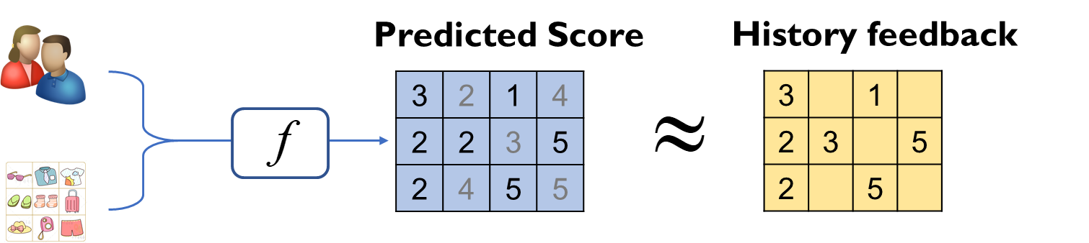
What is Recommender System?
Classic definition of RS --- Formulate RS as a ML problem:
A set of users:
A set of items:
Users history feedback on items:
To learn a model to predict preference for each user-item pair:
Minimizing the difference between the prediction and the observed feedback
7
Notes:
7

Slide 8
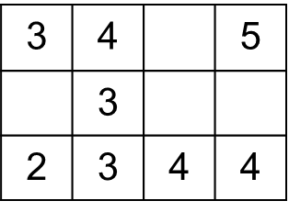
Recommender System
Feedback data:
Features of users and items:
IDs (Collaborative filtering), historical sequence (sequential recommendation), user/item contents (content-based recommendation).
Recommendation model:
1 | 1
 | 1 | 1 | 1
Explicit feedback
Implicit feedback
Matrix factorization
Factorization
machine
Deep learning:
CNN, CDAE, NCF
Deep & wide
Session RS:
GRURec, SASRec
Graph models:
NGCF, LightGCN
DIN
Large Models
2009
2010
2013 (2016)
2016
2018
2019
2023
8
Notes:
8

Slide 9
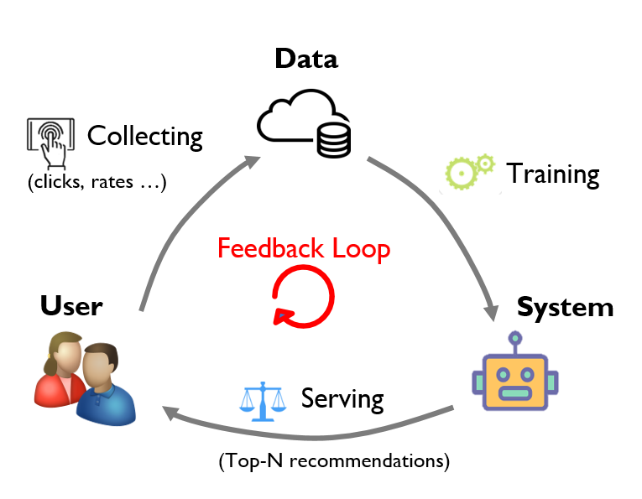
Recommender System
Workflow of RS
Training: RS is trained/updated on observed user-item interaction data.
Serving: RS infers user preference over items and exposes top-n items.
Collecting: User actions on exposed items are merged into the training data.
Forming a Feedback Loop
2023
9
Notes:
9

Slide 10
Recommender system
Background of Recommender System
Recommendation Models
Typical problems
Potential directions
10
Notes:
10

Slide 11
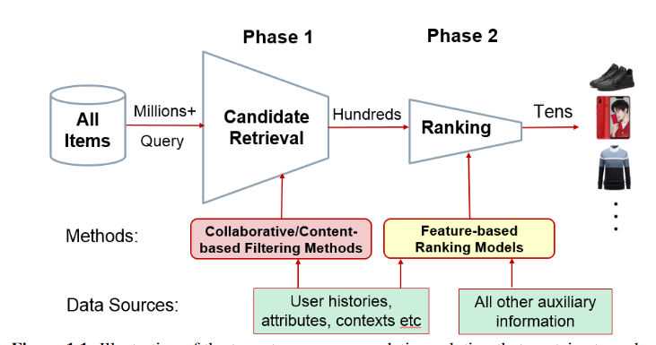
Recommender System
Two-stage recommendation
11
Notes:
11

Slide 12
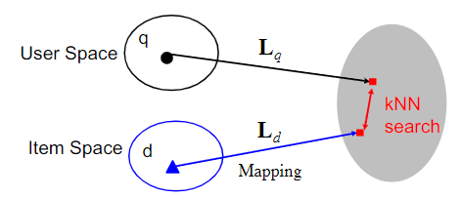
Recommender models
Candidate retrieval: learning user and item representation
Notes:
机器学习是基础。

Slide 13
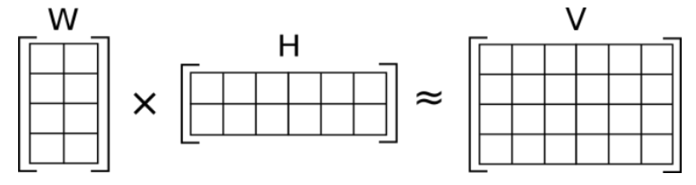
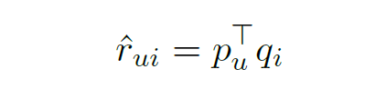
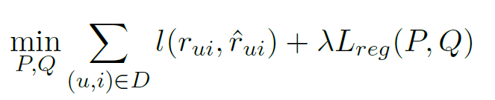



Recommender models
Matrix factorization
User features
items features
Feedback
$$P$$
$$R$$
$$Q$$
Notes:
机器学习是基础。

Slide 14
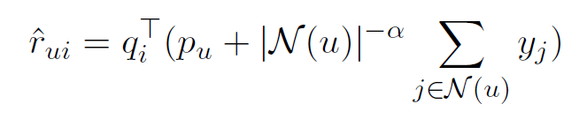
Recommender models
Information-enhanced Embedding Models
Weaknesses of MF:
Rely on the signal from the objective function
Poor performance of cold users/ items
Neighbor-based models:
enrich the user representation with his rating history
Notes:
机器学习是基础。

Slide 15
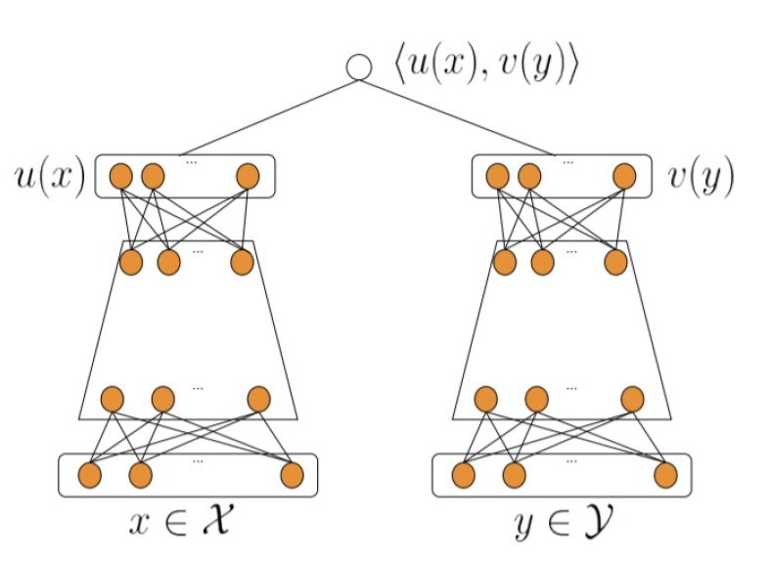
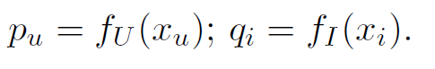
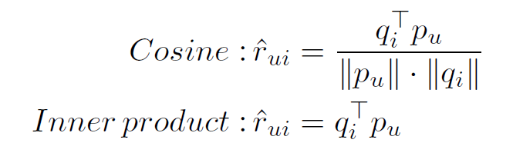
Recommender models
Information-enhanced Embedding Models
Feature-enriched embedding methods (two-tower structure):
Leveraging rich user and item features
We may profile a user with age, gender, education, revenue, etc
Flexible
Notes:
机器学习是基础。

Slide 16
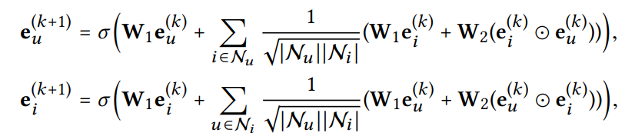
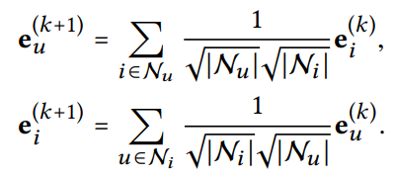
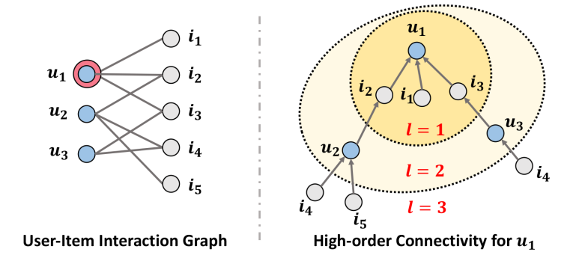
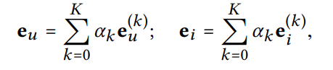
Recommender models
Information-enhanced Embedding Models
Graph-enriched embedding methods:
Weakness of existing methods: regard each user or item as a “isolated island, fail to explicitly encode their relations
SIGIR’20: Lightgcn: Simplifying and powering graph convolution network for recommendation (2k+)
Notes:
机器学习是基础。

Slide 17
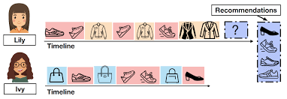
Recommender models
Information-enhanced Embedding Models
Methods with Modeling Sequential Dynamics
take user’s behavior sequences as input
Take the advantage of deep neural network
Notes:
机器学习是基础。

Slide 18
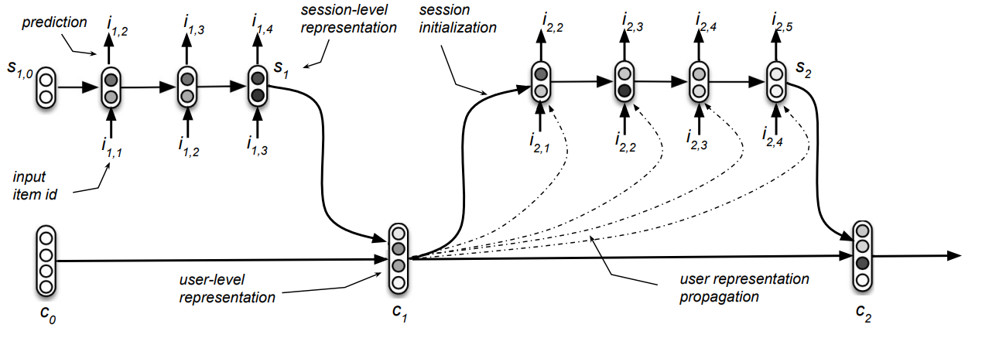
Recommender models
Methods with Modeling Sequential Dynamics
RNN-based methods that model sequential dependence with RNN or some improved versions like LSTM, GRU
Personalizing Session-based Recommendations with Hierarchical Recurrent Neural Networks
Notes:
机器学习是基础。

Slide 19
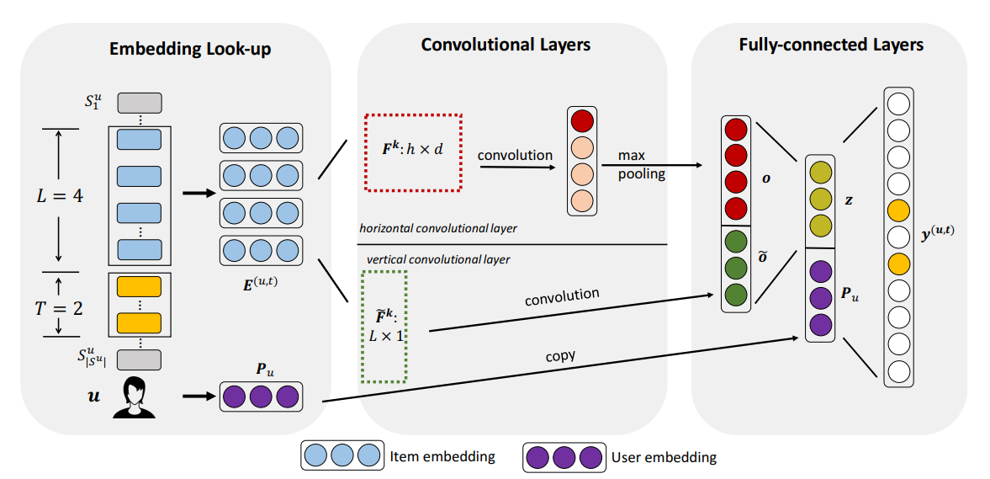
Recommender models
Methods with Modeling Sequential Dynamics
CNN-based methods that concatenates the embedding of previous item as a matrix and then treat the matrix as images
WSDM’18: Personalized Top-N Sequential Recommendation via Convolutional Sequence Embedding
Notes:
机器学习是基础。

Slide 20
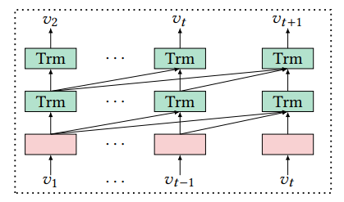
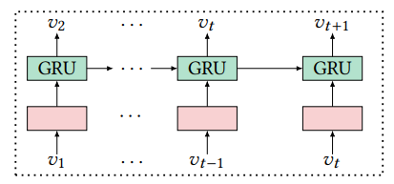
Recommender models
Methods with Modeling Sequential Dynamics
attention-based methods: introduce attention mechanism by considering user different behaviors would have different influences on user’s next behaviors
RNN-based
Attention-based
WSDM’18: Self-Attentive Sequential Recommendation
Notes:
并行、显示建模长期关系。

Slide 21
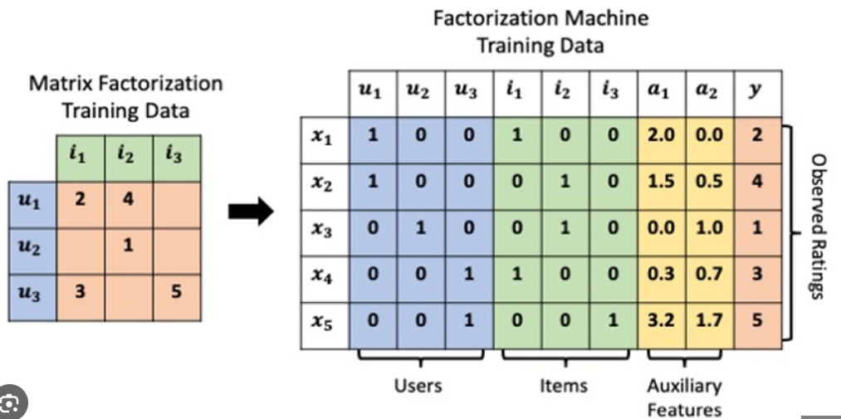
Recommender models
Candidate (finely) Ranking Models: mainly focus on modeling the interactions between features.
Notes:
机器学习是基础。

Slide 22
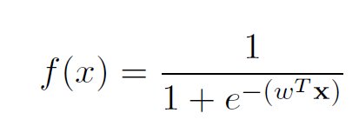
Recommender models
Liner models
collects features (users, items, contexts) into a numerical feature vector
leverage linear function to map the feature vector into the final predicted score:
Notes:
机器学习是基础。

Slide 23
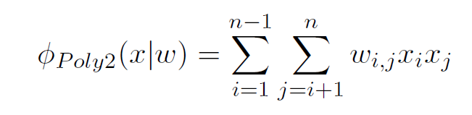

Recommender models
Polynomial models
Modeling high-order feature interactions
Naïve strategy: explicitly modeling 2-order interactions
Too many parameters: inefficiency & high memory cost $O(n^{2})$
Notes:
机器学习是基础。

Slide 24
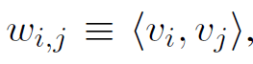
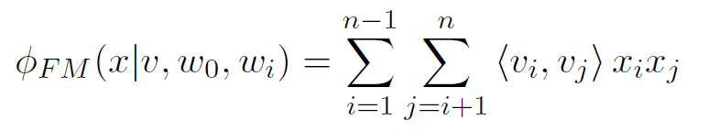
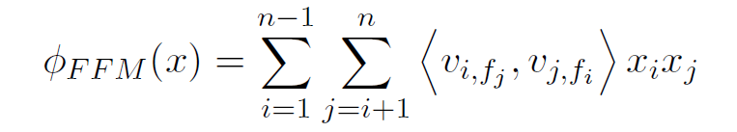
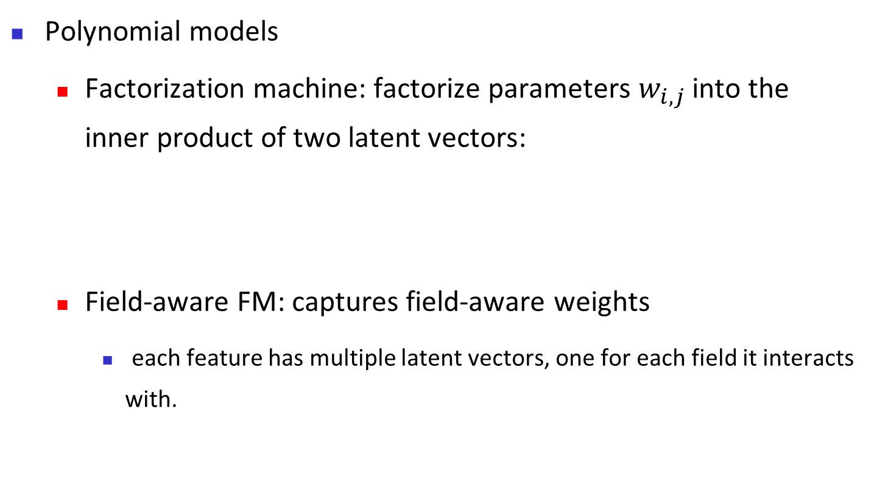
Recommender models
Polynomial models
Factorization machine: factorize parameters $w_{i,j}$ into the inner product of two latent vectors:
Field-aware FM: captures field-aware weights
each feature has multiple latent vectors, one for each field it interacts with.
ICDM’10: Factorization machines
Recsys’16: Field-aware factorization machines for CTR prediction
Notes:
捕捉到每个特征和不同域交互的重要性。

Slide 25
Recommender models
Neural network models
neural networks are able to capture more complex feature interactions due to their powerful expression ability
Three research threads:
Directly developing better feature interaction modules
stands on the shoulder of FM models
leveraging attention mechanism in capturing diverge and dynamic contribution of different feature interactions
Notes:
捕捉到每个特征和不同域交互的重要性。

Slide 26
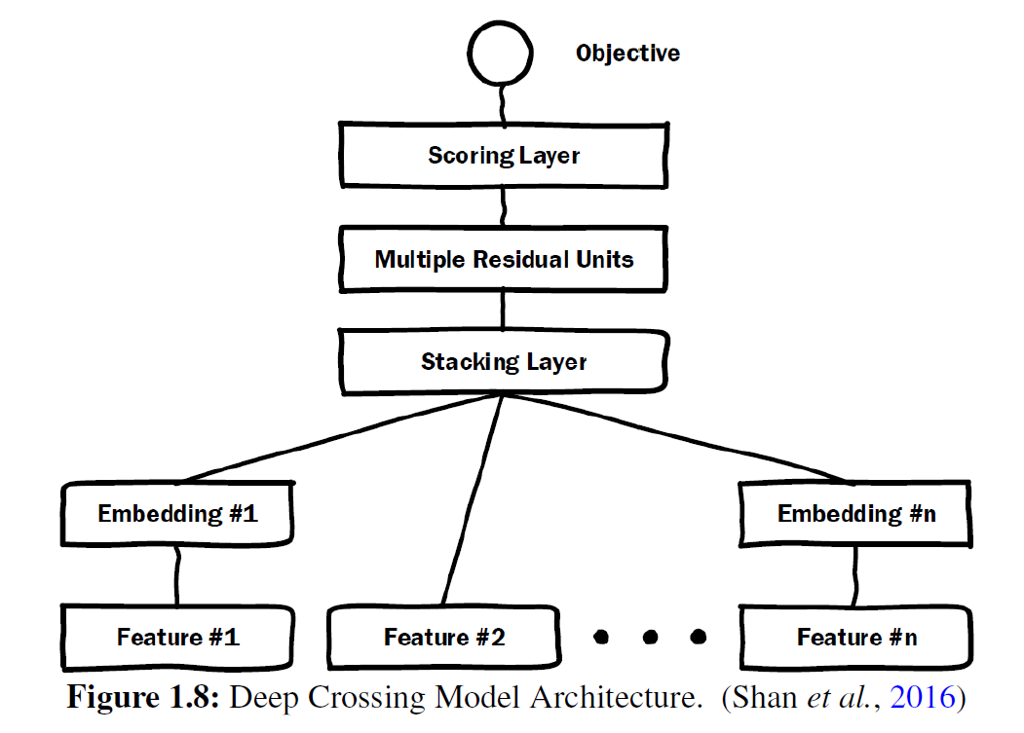
Recommender models
Neural-based Feature Interactions
Deep Crossing
Embedding layer: transfer sparse features into dense vectors
Stacking layers: This layer concatenates different embedding features
Multiple Residual Units Layer: perform feature interaction via Residual Net
KDD’16: Deep crossing: Web-scale modeling without manually crafted combinatorial features
Notes:
捕捉到每个特征和不同域交互的重要性。

Slide 27
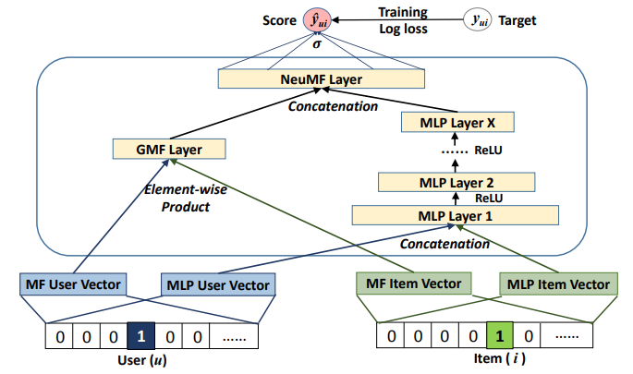
Recommender models
Neural-based Feature Interactions
Neural Collaborative filtering
WWW’17: Neural Collaborative filtering (5K+)
Notes:
捕捉到每个特征和不同域交互的重要性。

Slide 28
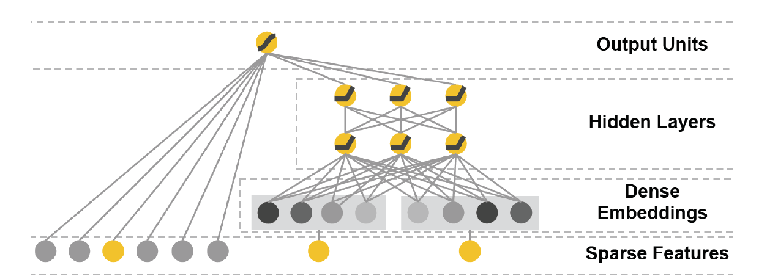
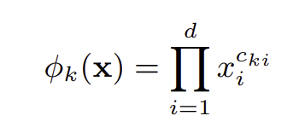
Recommender models
Neural-based Feature Interactions
Wide & Deep: deep neural network exhibits high generalization but suffers when the user-item interactions are sparse
Combining neural network with explicit feature interactions
Notes:
捕捉到每个特征和不同域交互的重要性。

Slide 29
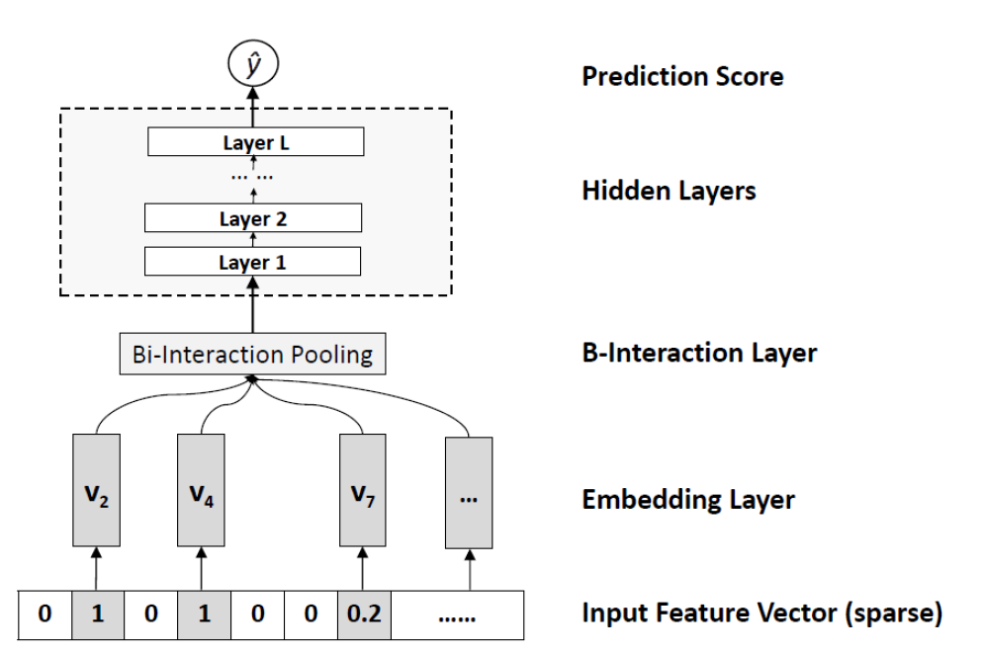
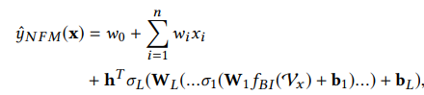
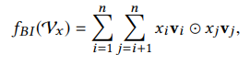
Recommender models
Emdowing FM with neural networks
Combining the cability of FM and neural network
Neural Factorization Machines: FM-> neural network
SIGIR’17: Neural Factorization Machines for Sparse Predictive Analytics
Notes:
捕捉到每个特征和不同域交互的重要性。

Slide 30
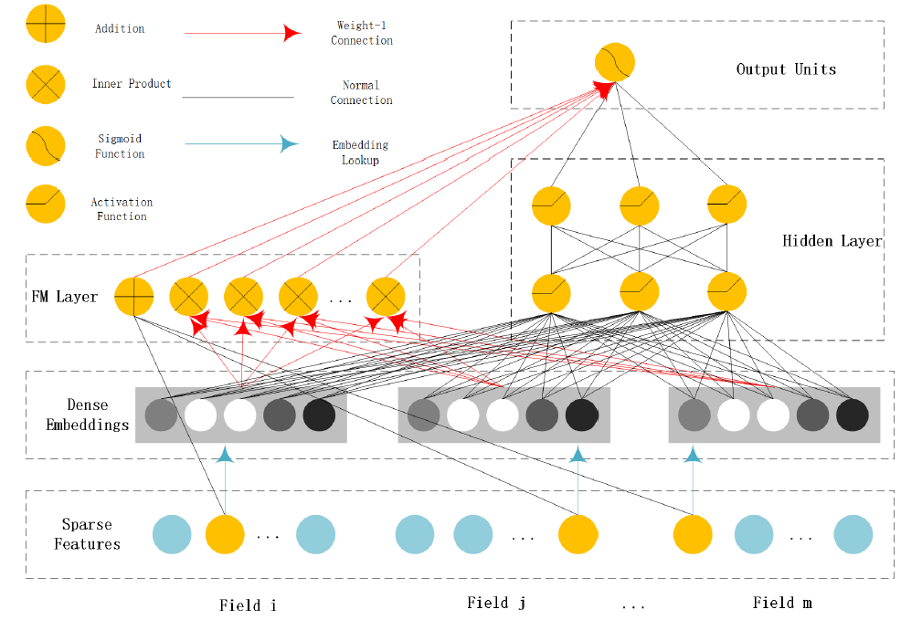
Recommender models
Emdowing FM with neural networks
DeepFM: FM + neural network
ICDM’16: DeepFM: a factorization-machine based neural network for CTR prediction （2K+）
Notes:
捕捉到每个特征和不同域交互的重要性。

Slide 31
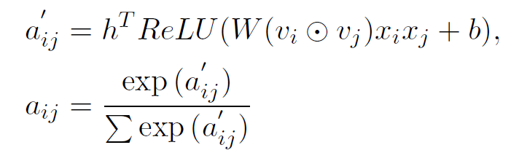
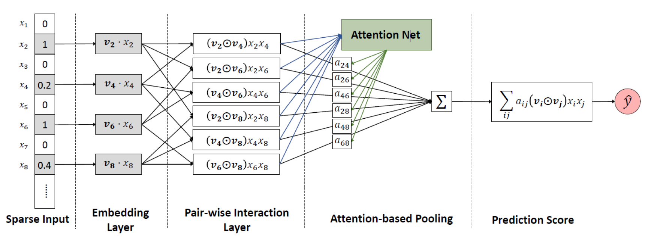
Recommender models
Leveraging Attention Mechanism
Attentional Factorization Machine: giving weights on the feature interactions
Notes:
捕捉到每个特征和不同域交互的重要性。

Slide 32
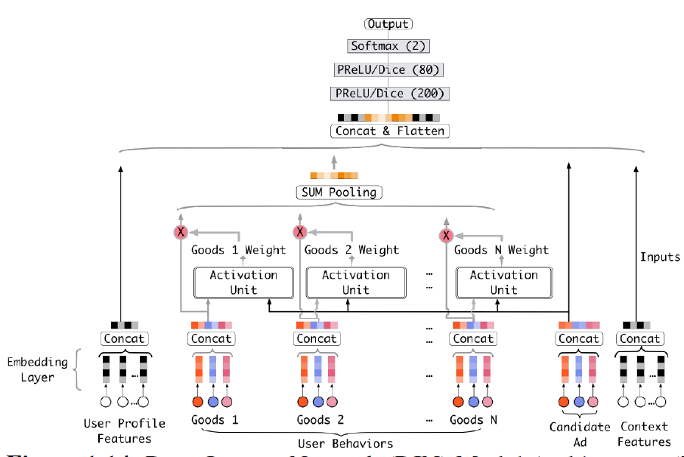
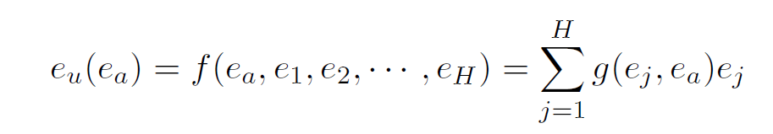
Recommender models
Leveraging Attention Mechanism
Deep interest network: learn the representation from historical behaviors by taking into consideration the relevance of historical behaviors given a candidate item.
KDD’18: Deep interest network for click-through rate prediction
Notes:
捕捉到每个特征和不同域交互的重要性。

Slide 33
Recommender system
Background of Recommender System
Recommendation Models
Typical problems
Potential directions
33
Notes:
33

Slide 34
Typical problems
Typical problems: how RS differs from ML?
Learning to rank
Long-tailed
Data Bias
34
Notes:
34

Slide 35
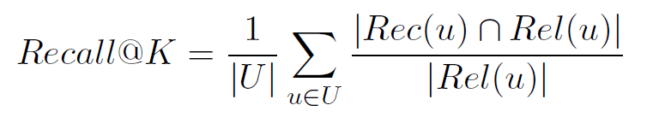
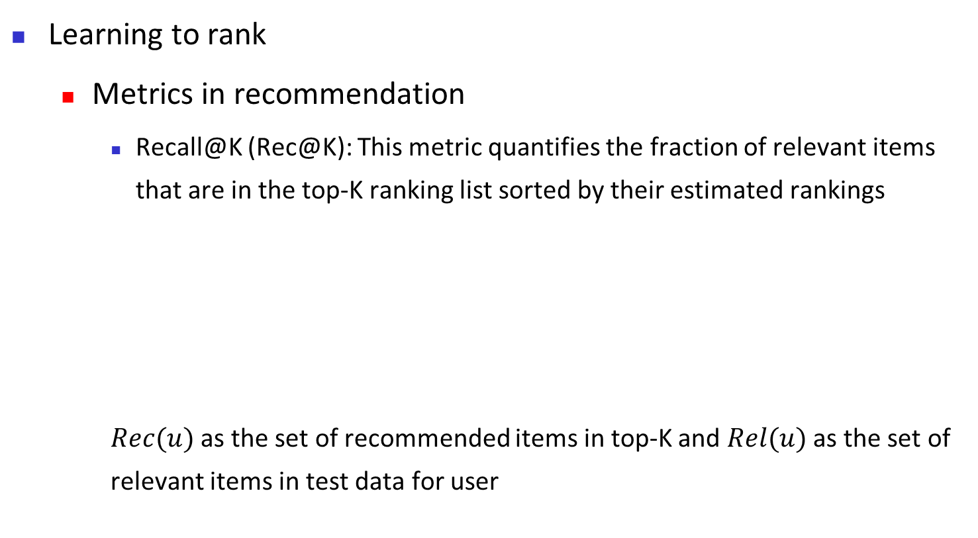
Typical problems
Learning to rank
Metrics in recommendation
Recall@K (Rec@K): This metric quantifies the fraction of relevant items that are in the top-K ranking list sorted by their estimated rankings
$Rec(u)$ as the set of recommended items in top-K and $Rel(u)$ as the set of relevant items in test data for user
35
Notes:
35

Slide 36
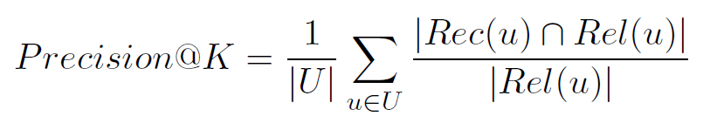
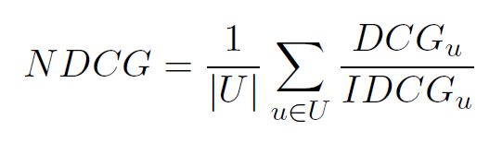
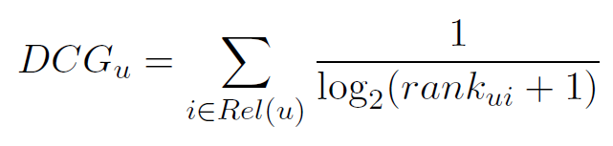
Typical problems
Learning to rank
Metrics in recommendation
Precision@K (Pre@K): This measures the fraction of the top-K items that are indeed favored by the user
Normalized Discounted Cumulative Gain (NDCG): This is widely used in information retrieval and it measures the quality of ranking through discounted importance based on positions
36
Notes:
36

Slide 37
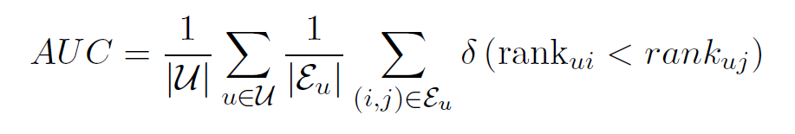
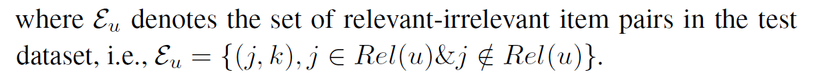
Typical problems
Learning to rank
Metrics in recommendation
Area Under the Curve (AUC), which measures the probability of two
items being in a correct order that the relevant item is ranked higher
than the irrelevant item
37
Notes:
37

Slide 38
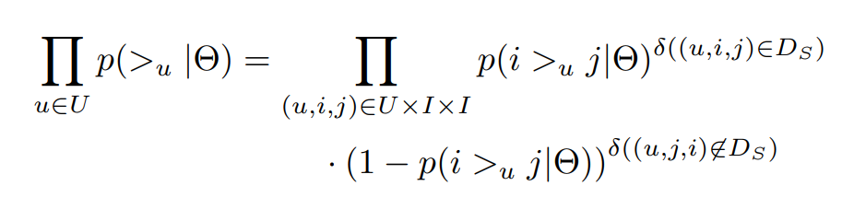


Typical problems
Learning to rank
Ranking rather than classification
BPR loss: optimizing ranking relations (AUC)
BPR: Bayesian Personalized Ranking from Implicit Feedback (6K+)
38
Notes:
38

Slide 39

Typical problems
Learning to rank
How to directly optimize NDCG?
Learning a surrogate loss!!
SIGIR’21: A Guided Learning Approach for Item Recommendation via Surrogate Loss Learning
39
Notes:
39

Slide 40
Typical problems
Typical problems: how RS differs from ML?
Learning to rank
Long-tailed
Data Bias
40
Notes:
40

Slide 41

Typical problems
Long-tailed data
Few popular items which take up the majority of rating interactions while the majority of the items receive small attention from the users.
41
Notes:
41

Slide 42

Typical problems
Long-tailed data
Algorithm not only inherit bias from data, but also amplify the bias.
—— the rich get richer and the poor get poorer
Each group has the same number of interactions in the training set
42
Notes:
42

Slide 43
Typical problems
Harmful of long-tailed data
Resulting in Matthew effect and filter bubble
affects recommendation accuracy
Unfairness --- hurt user experience
Amplification during he loop
43
Notes:
43

Slide 44


Typical problems
Solutions for long-tailed data
Regularization
Fairness-aware : ${tr(Q}^{⊤}L_{D}Q)$ $⇒$ $\min_{L_{u}}{\frac{1}{N(N−1)}\sum_{ij∈R_{u}}{d_{ij}}}$
$$D_{ij}=d_{ij}=\left\{\begin{aligned}0, pop\left(i\right)≠pop(j) \\ 1, pop\left(i\right)=pop(j) \end{aligned}\right.$$
Decorrelation : $PCC{\left(\hat{R},pop\left(I\right)\right)}^{2}$
where $\hat{R}=P^{⊤}Q$ , pop(I) is the popularity of $I$,
and PCC is Pearson Correlation Coefficient
$$\min_{\left\{P,Q\right\}} L_{acc}\left(P,Q\right)+λL_{pop_reg}(P,Q)$$
Recommendation Loss
Regularization term for adjusting recommendation list
[1]. Abdollahpouri, Himan et.al. "Controlling popularity bias in learning-to-rank recommendation.” In RecSys 2017.
[2]. Ziwei zhu et.al. “Popularity-Opportunity Bias in Collaborative Filtering.” In WSDM 2021.
44
Notes:
44

Slide 45

Typical problems
Solutions for long-tailed data
Disentangle user interest, benign item popularity and harmful item popularity:
(1) I → Q → Y : This link denotes the effect of item quality on user behavior
(2) (I, t) → C → Y : These links represent the timeaware conformity effect on user behavior
(3) (U, I) → M → Y : these links project user and item features (e.g., IDs) into their matching scores
TKDE’22: Popularity Bias Is Not Always Evil: Disentangling Benign and Harmful Bias
for Recommendation
45
Notes:
45

Slide 46
Typical problems
Typical problems: how RS differs from ML?
Learning to rank
Long-tailed
Data Bias
46
Notes:
46

Slide 47

Typical problems
Data Bias
TOIS’23: Bias and debias in recommender system: A survey and future directions
47
Notes:
47

Slide 48

Typical problems
Impact of Data Bias
48
Notes:
48

Slide 49

Typical problems
Data Bias in RS
49
Notes:
49

Slide 50

Typical problems
Data Bias in RS
50
Notes:
50

Slide 51

Typical problems
Exposure bias
51
Notes:
51

Slide 52

Typical problems
Exposure bias
52
Notes:
52

Slide 53

Typical problems
Conformity bias
53
Notes:
53

Slide 54

Typical problems
Position bias
54
Notes:
54

Slide 55
Typical problems
Debiasing strategies
Re-weighting
Giving weights for each instance to re-scale their contributions on model training
Re-labeling
Giving a new pseudo-label for the missing or biased data
Generative Modeling
Assuming the generation process of data and reduces the biases accordingly
Robust optimization
Optimizing the model under perturbation
55
Notes:
55

Slide 56

Typical problems
Re-weighting strategies
56
Notes:
56

Slide 57

Typical problems
Re-weighting strategies
57
Notes:
57

Slide 58

Typical problems
Re-labeling strategies
58
Notes:
58

Slide 59

Typical problems
Re-labeling strategies
59
Notes:
59

Slide 60

Typical problems
Re-labeling + reweighting strategies
60
Notes:
60

Slide 61

Typical problems
Generative modeling
61
Notes:
61

Slide 62

Typical problems
Generative modeling
62
Notes:
62

Slide 63


Typical problems
Robust optimization
Contrastive learning --- heuristic perturbation
Addressing sparse supervised labels.
Relying on human expertise.
63
Notes:
63

Slide 64


Typical problems
Robust optimization
Contrastive learning --- heuristic perturbation
ED: Edge drop-out,
ND: Node drop-out,
RW: Random Walk
64
Notes:
64

Slide 65


Typical problems
Robust optimization
Distributional robust optimization --- adversarial perturbation
ensures that the model performs well on a family of distributions that are within a certain distance from the current distribution.
65
Notes:
65

Slide 66


Typical problems
General.
Theoretical-soundness.
Robust optimization
Distributional robust optimization
$$\min_{θ}\max_{P∈ℙ} E_{x\sim P}[H(x;θ)]$$
$$ℙ=\left\{P∈𝔻:D\left(P∥P_{0}\right)≤η\right\}$$
Over-pessimism.
$θ$ represents model parameters and $x$represents data;
$P_{0}$ represents the training data distribution;
$D\left(P∥P_{0}\right)$ measures the distance between distributions $P$ and $P_{0}$;
$η$ denotes the robust radius;
66
Notes:
66

Slide 67

Typical problems
Robust optimization
Distributional robust optimization
SIGIR’23: A Generic Learning Framework for Sequential Recommendation with Distribution Shifts
67
Notes:
67

Slide 68

Typical problems
Robust optimization
Distributional robust optimization
68
Notes:
68

Slide 69
Recommender system
Background of Recommender System
Recommendation Models
Typical problems
Potential directions
69
Notes:
69

Slide 70
Recommender system
Potential directions
Large language model for recommendation
Fundamental problems in RS
Taking feedback loop into consideration
70
Notes:
70

Slide 71
Recommender system
Large language model for recommendation
LLM brings extra knowledge
LLM has a better reasoning capability
Rule-based
Machine learning
Deep learning
Large Models
2000
2009
2016
2023
71
Notes:
71

Slide 72


Recommender system
How to leverage LLM in recommendation?
LLM for feature augmentation
72
Notes:
72

Slide 73

Recommender system
How to leverage LLM in recommendation?
LLM for recommendation, Prompt is the key
73
Notes:
73

Slide 74

Recommender system
How to leverage LLM in recommendation?
LLM for recommendation, Prompt is the key
74
Notes:
74

Slide 75
Recommender system
LLM for recommendation
Challenges:
Efficiency: latency of LLM
How to combine the collaborative signals and LLM
75
Notes:
75

Slide 76
Recommender system
Fundamental problems in RS
Ranking! Ranking! Ranking!
How to optimize top-N metrics
Better Loss
76
Notes:
76

Slide 77
Recommender System
Candidate retrieval and ranking --- combined
bridge the efficiency and effectiveness trade-off
77
Notes:
77

Slide 78
Recommender System
Theoretical understanding of model complexity, learning dynamic, bias amplification, etc.
78
Notes:
78

Slide 79


Recommender system
Taking feedback loop into consideration
Long-termed rewards --- user experience, multiple objectives
Exploration- exploitation trade-off
Bandit
79
Notes:
79

Slide 80

Thank you!
Notes:
Thank you! Due to the time is limited. I can not give the answers of your questions now.
But please feel free to contact us with e-mail, we will give your feedback as soon as possible.

